Slide 1
Chapter 4 Discrete System Simulation
Prepared By:
Asst. Prof. Sundar Kunwar
Department of Computer Science and Engineering
Nepal Engineering College

Slide 2
Discrete Event Simulation
A number used to represent some aspect of the system is called a state descriptor.
Eg:- no of pages in book, flag value either 0 or 1 and so on.
Discrete system is a system in which the changes are instantaneous.
As simulation proceeds, the state descriptors change value.
Each change in the state of system is called as an event.
For Example, arrival or departure of a customer in a queue is an event.
The simulation of a discrete system is referred to as discrete event simulation.

Slide 3
Discrete Event Simulation
Applications of discrete event simulation:
• It is used by operation research workers to study large complex systems which cannot be studied by analytical method.
• In inventory control.
• Study of sea and airport.
• Steel melting stuffs.
• Telephone exchanges.
• Production line.
• Project scheduling etc.

Slide 4
Representation of time
There are two different models for moving a discrete system through time.
• Fixed time step model or interval oriented model
• Event to event(next event ) model or event oriented model
Fixed time step model v/s next event model:
• In a fixed time step model a timer or clock is simulated by the computer.
• This clock is updated by a fixed time interval Ϫ and the system is examine to see if any event has taken place during this time interval.

Slide 5
Representation of time..
In the next event simulation model, the computer advances time to the occurrence of the next event. It shifts from event to event
The system does not change in between only those points in time are kept track when something of interest happens to the system.

Slide 6
Generation of Arrival Pattern
Generation of arrival patterns can be done in following two methods:-
Trace driven simulation:
Here the sequence of inputs are generated from observations of a running system.
Programs monitors are attached to the running system to extract the data with little or no disturbances of the system operation.

Slide 7
Generation of Arrival Pattern..
Bootstrapping:
Here the arrival time of the next entity is immediately calculated from the inter-arrival time distribution.
The term bootstrapping is used to describe this process of making one entity create its successor.
The method requires keeping only the arrival time of the next entity.
It is the most preferred method of generating arrival through computer simulation program.

Slide 8
Simulation of Telephone System
The System has a number of Telephone connecting to a switch board by lines.
A switch has a number of links which can be used to connect any two lines subject to the condition that only one connecting at a time can be made to each line.
It assume that it lost call system. A call may be lost because no link is available it is called as a lost call.
The object of the simulation is to process a given number of calls and determine what proportion are successfully completed block or busy.
The current state of the system is that lne-2 is connected to line-5 and a line-4 is connected to line-7.
Each line is treated as an entity and it’s availability is an attribute a table of numbers is establish which show the current status of each line.
A zero in the table means the line is free and where 1 means it is busy.

Slide 9
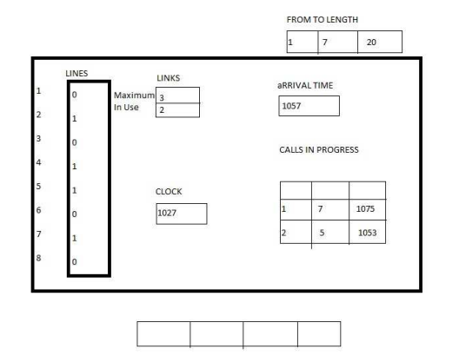

Slide 10
Simulation of Telephone System..
To keep track of event the number of representing currently the clock time 5 1027.
The unit of time is taken to be in second. There is a list of call in progress showing which line call is connected and the time each call finishes.
The arrival of call is generated by the boot strapping technique.
There are 2 activities causing event.
1. New calls can arrive
2. Existing calls can finish

Slide 11
Simulation of Telephone System..
There are 3-future events :
• The call between lines 2 and 5 is due to finish at time 1053.
• The call between line 4 and 7 is due to finish at time 1075.
• A new call is due to arrive at time 1057.
The simulation proceeds by exhibiting a cycle of state to simulate each event.
Steps:- 1. Find the next potential event.
2. Select an activity.
3. Test if the event can be executed.
4. Change the system event.
5. Gather statistics.
The simulation will be run until a given number of calls have been processed or until the simulation time has elapsed.

Slide 12
Simulation of Telephone System..
Delayed Call
Suppose the telephone system is modified so that cannot be connected are not loosed instead the wait until they can be connected, they have called as delayed calls.
To keep records of these delayed calls a delayed call list is made.
When a call completely ends, it is necessary to check the delayed call list to see if a waiting call can be connected.

Slide 13
Gathering statistics
The statistics of interested variables has to be gathered during simulation and the selection variables depend on the nature of our simulation studies.
For example
Counts,
Summary measures,
Utilization, Occupancy
Transit times etc.

Slide 14
Gathering statistics
Counts:
are number of entities or events. e.g. No. of devices, No. of links, Blocked call events etc.
Summary measures:
Extreme values, Mean and standard deviations etc. For example Maximum links in telephone system.
Utilization:
Fraction or percentage of time that some entities get engaged.
Occupancy: -
Links available to use. - Fractions or percentage of a group of entities on average.
Distribution:
Distribution of important values, such as waiting time in SSQM.
Transit time:
Time taken for an entity to move from one part of the system to the other part.

Slide 15
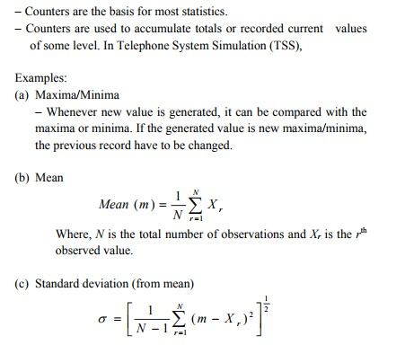
Counter and Summary statistics

Slide 16
Measuring utilization and occupancy
Utilization is a statistics that gives a measure of the load on some entity (Variables).
For example, in TSS what fraction of item i.e. individual line was engaged or busy during the simulation run.
In single server queuing model, the server utilization i.e. the proportion of time the server is busy.

Slide 17
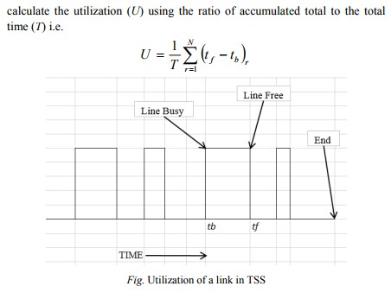

Slide 18
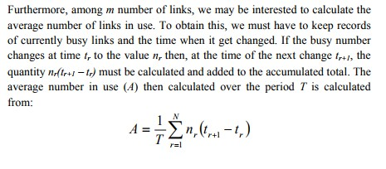

Slide 19
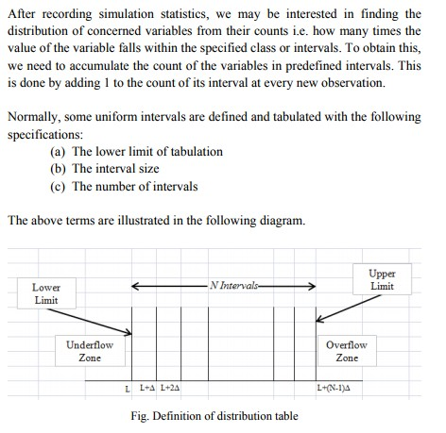
Recording distribution and Transit

Slide 20
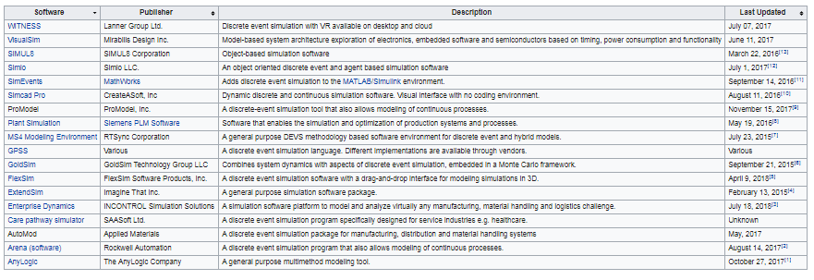
Discrete Simulation Language https://en.wikipedia.org/wiki/List_of_discrete_event_simulation_software

Slide 21
Simulation Programming Tasks
There are three main tasks to be performed:
1. Model generation: This part includes model generation and initialization. A set of variables for system representation is to be created to show the status of the system state at all the time which is known as system image (state). Some procedures are also to be defined to represent the activities involved in the system which updates the system variable in run time.
2. Model simulation: A simulation algorithm has to be employed to carry out the simulation task. This procedure executes the cycle of predefined actions during simulation.
3. Report generation: A report generator gathers the statistics of interested variables and generates the simulation report in an organized way.

Slide 22
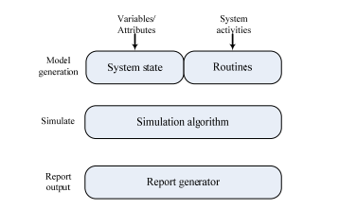
Simulation Programming Tasks

Slide 23
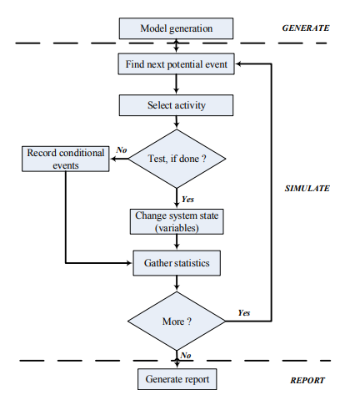
Simulation Programming Tasks

Slide 24
Assignment
What is state descriptor and discrete even in discrete system simulation? Explain with suitable example.
How is time represented in discrete system simulation?
How are arrival patterns generated in discrete system simulation?
What is lost and delay call system? Explain the simulation of telephone system with necessary state diagrams.
What are the tasks to be performed in simulation programming? Also list out the activities to be performed in execution of simulation algorithm with neat diagram.
Write short notes on:
Gathering Statistics
Counter and Summary Statistics
Measuring Utilization and Occupancy
Recording Distribution and Transit Time
Discrete Simulation Language

